Slide 1


chen pan
2022.01.20

Slide 2

Outline
Executive Summary
Introduction
Methodology
Results
Conclusion
Appendix

Slide 3
Executive Summary
Data Collection API with Webscraping, Data wrangling
Exploratory Analysis Using SQL, Pandas, Matplotlib
Interactive Visual Analytics and Dashboard
Predictive Analysis (Classification, KNN, DT, SVM, LR )
Summary of all results, method performs best predict score 0.84

Slide 4
Introduction
SpaceX advertises Falcon 9 rocket launches on its website with a cost of 62 million dollars; other providers cost upward of 165 million dollars each, much of the savings is because SpaceX can reuse the first stage. Therefore if we can determine if the first stage will land, we can determine the cost of a launch.
we will predict if the Falcon 9 first stage will land successfully

Slide 5


Slide 6
Methodology
Executive Summary
Data collection methodology:
Describe how data was collected
Perform data wrangling
Describe how data was processed
Perform exploratory data analysis (EDA) using visualization and SQL
Perform interactive visual analytics using Folium and Plotly Dash
Perform predictive analysis using classification models
How to build, tune, evaluate classification models

Slide 7
Data Collection
Request and parse the SpaceX launch data using the GET request
static_json_url='https://cf-courses-data.s3.us.cloud-object-storage.appdomain.cloud/IBM-DS0321EN-SkillsNetwork/datasets/API_call_spacex_api.json'
from pandas.io.json import json_normalize
response = requests.get(static_json_url).json()
data = pd.json_normalize(response)
Filter the dataframe to only include Falcon 9 launches
data_falcon9 = df_launch[df_launch.BoosterVersion!='Falcon 1']
Dealing with Missing Values
PM_mean = data_falcon9.PayloadMass.mean().round(1)
data_falcon9['PayloadMass'].replace(np.nan,PM_mean,inplace=True)

Slide 8
Data Collection - Scraping
Request the Falcon9 Launch Wiki page from its URL
data = requests.get(static_url).text
soup = BeautifulSoup(data, 'html5lib')
Extract all column/variable names from the HTML table header
html_tables = soup.find_all('table')
for row in first_launch_table.find_all('th'):
name = extract_column_from_header(row)
if (name != None and len(name) > 0):
column_names.append(name)
Create a data frame by parsing the launch HTML tables

Slide 9
Data Wrangling
Calculate the number of launches on each site
Calculate the number and occurrence of each orbit
Calculate the number and occurence of mission outcome per orbit type
Create a landing outcome label from Outcome column

Slide 10
EDA with Data Visualization
Visualize the relationship between Flight Number and Launch Site
Visualize the relationship between Payload and Launch Site
Visualize the relationship between success rate of each orbit type
Visualize the relationship between FlightNumber and Orbit type
Visualize the relationship between Payload and Orbit type
Visualize the launch success yearly trend
Create dummy variables to categorical columns
Cast all numeric columns to float64

Slide 11
Predictive Analysis (Classification)
Create a NumPy array from the column Class in data, by applying the method to_numpy() then assign it to the variable Y,make sure the output is a Pandas series (only one bracket df['name of column']).
Standardize the data in X then reassign it to the variable X using the transform provided below.
Use the function train_test_split to split the data X and Y into training and test data. Set the parameter test_size to 0.2 and random_state to 2. The training data and test data should be assigned to the following labels.
Create a logistic regression object then create a GridSearchCV object logreg_cv with cv = 10. Fit the object to find the best parameters from the dictionary parameters.
Calculate the accuracy on the test data using the method score:
Create a support vector machine object then create a GridSearchCV object svm_cv with cv = 10. Fit the object to find the best parameters from the dictionary parameters.
Calculate the accuracy on the test data using the method score:
Create a decision tree classifier object then create a GridSearchCV object tree_cv with cv = 10. Fit the object to find the best parameters from the dictionary parameters.
Calculate the accuracy of tree_cv on the test data using the method score:
Create a k nearest neighbors object then create a GridSearchCV object knn_cv with cv = 10. Fit the object to find the best parameters from the dictionary parameters.
Calculate the accuracy of tree_cv on the test data using the method score:
Find the method performs best

Slide 12
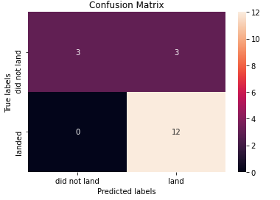
Results
Exploratory data analysis results
logreg_cv.score(X_test, Y_test) 0.84
svm_cv.score(X_test,Y_test) 0.84
tree_cv.score(X_test,Y_test) 0.84
knn_cv.score(X_test,Y_test) 0.84

Slide 13


Slide 14
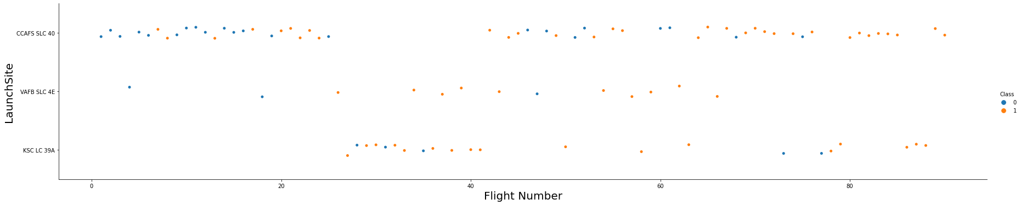
Flight Number vs. Launch Site
Lower flight number，failure more
KSC and CCAFS with high flight, and sucessful more

Slide 15
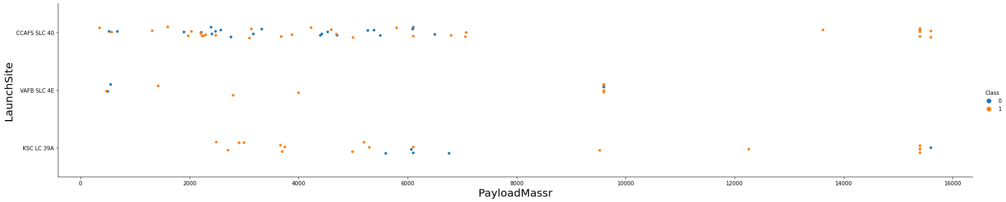
Payload vs. Launch Site
observe Payload Vs. Launch Site scatter point chart you will find for the VAFB-SLC launchsite there are no rockets launched for heavypayload mass(greater than 10000)

Slide 16
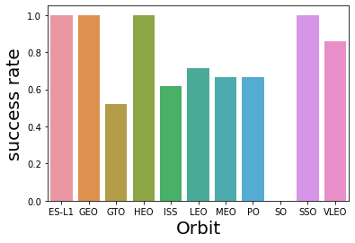
Success Rate vs. Orbit Type
Succsee rate of orbit SO of is the lowerest.
ES-L1, GEO, HEO, SSO with high success rate as 1

Slide 17
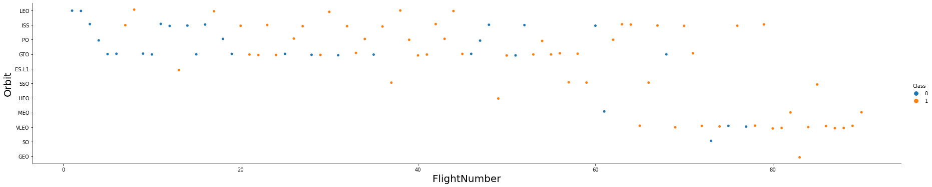
Flight Number vs. Orbit Type
You should see that in the LEO orbit the Success appears related to the number of flights; on the other hand, there seems to be no relationship between flight number when in GTO orbit.

Slide 18
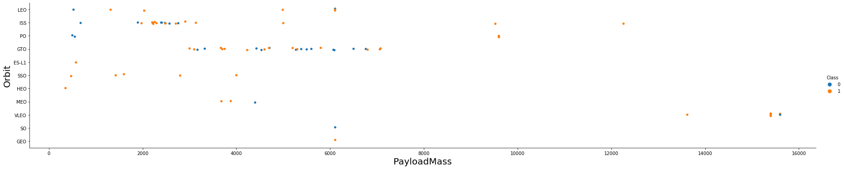
Payload vs. Orbit Type
With heavy payloads the successful landing or positive landing rate are more for Polar,LEO and ISS.
However for GTO we cannot distinguish this well as both positive landing rate and negative landing(unsuccessful mission) are both there here.

Slide 19
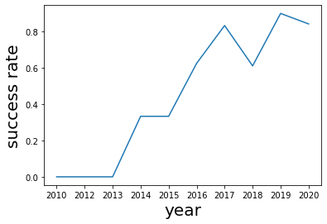
Launch Success Yearly Trend
you can observe that the sucess rate since 2013 kept increasing till 2020

Slide 20


Slide 21
Classification Accuracy
logreg_cv.score(X_test, Y_test) 0.84
svm_cv.score(X_test,Y_test) 0.84
tree_cv.score(X_test,Y_test) 0.84
knn_cv.score(X_test,Y_test) 0.84
model scores are the same

Slide 22
Confusion Matrix
precision TP/(TP+FP)= 0.8
recall TP/(TP+FN)= 0.8
accuracy (TP+TN)/(TP+FP+TN+FN) = 0.834
error_rate (FN+FP)/(TP+FP+TN+FN) = 0.166
F1 = 2*P*R/(P+R) = 0.8

Slide 23
Conclusions
classification model precision 0.8
classification model recall 0.8
…

Slide 24
Appendix
Include any relevant assets like Python code snippets, SQL queries, charts, Notebook outputs, or data sets that you may have created during this project

Slide 25


